Slide 1


The Quest for Mjolnir
Finding Thor’s hammer through the power of data analysis

Slide 2

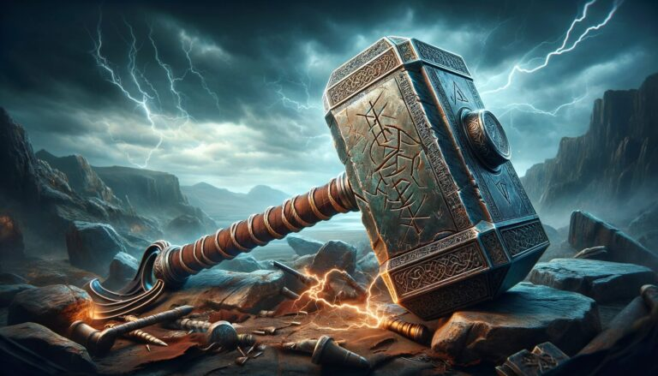
Introduction and assumptions
Hypothesis: Mjolnir (Thor’s Hammer) fell on earth and was covered up as a normal meteorite landing. Since Thor is the god of thunder, his hammer’s arrival would be accompanied with thunderstorms.
Goal: Find weather stations in range of as many meteorite landings as possible and determine if there were more thunderstorms than normal around the time when the meteorite landed.
Selection Criteria 1: The number of thunderstorms in the year the meteorite landed is 10 or more above the average
Selection Criteria 2: The number of thunderstorms in the year the meteorite landed is over 50% more than the average
The following two datasets were used:
National Centers for Environmental Information Global Surface Summary of Day Data (GSOD)
NASA comprehensive data set of Meteorite Landings from The Meteoritical Society

Slide 3
Data analysis flowchart
Scrape raw weather data from online databases
Initial analysis of weather station data to find thunderstorm statistics
Analysis of meteorite data to match with local weather stations and filter with selection criteria
Create charts and graphs

Slide 4
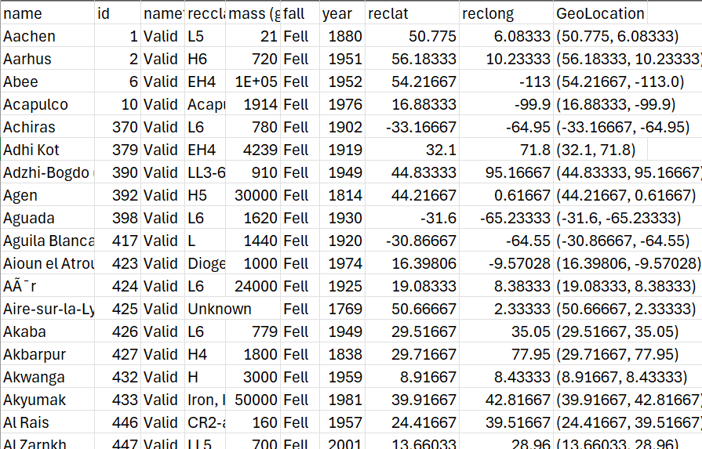
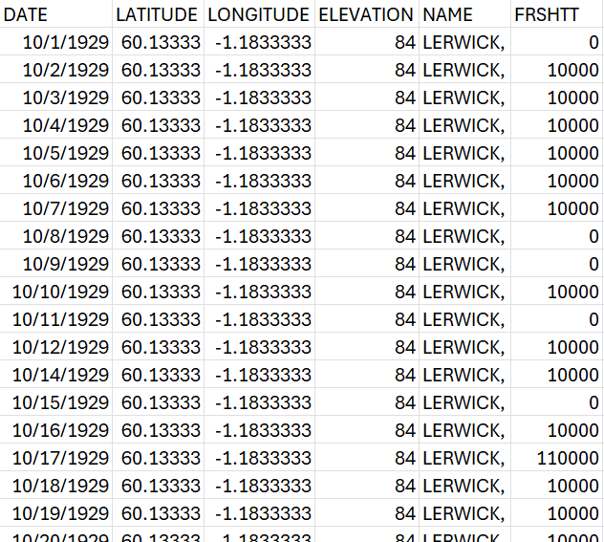
Data structures
Meteorite Data
Weather Station Data

Slide 5
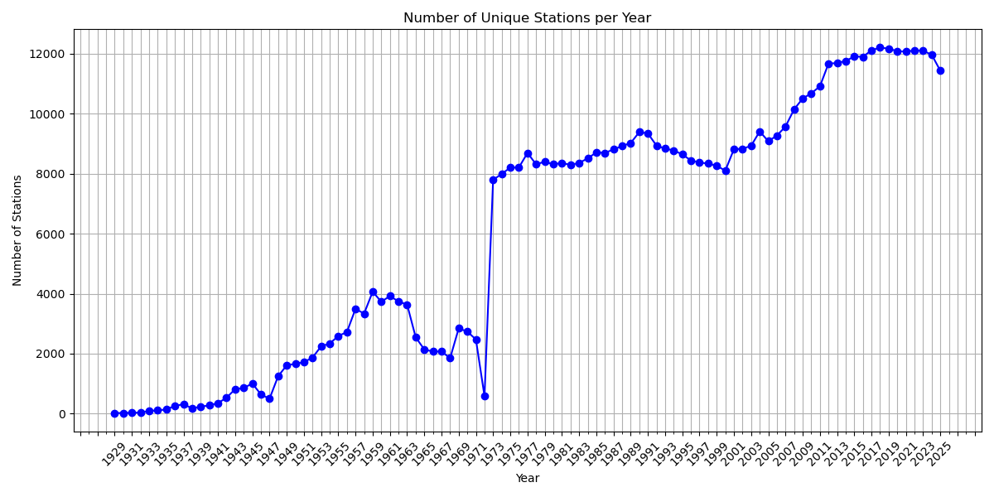
Number of weather stations per year

Slide 6
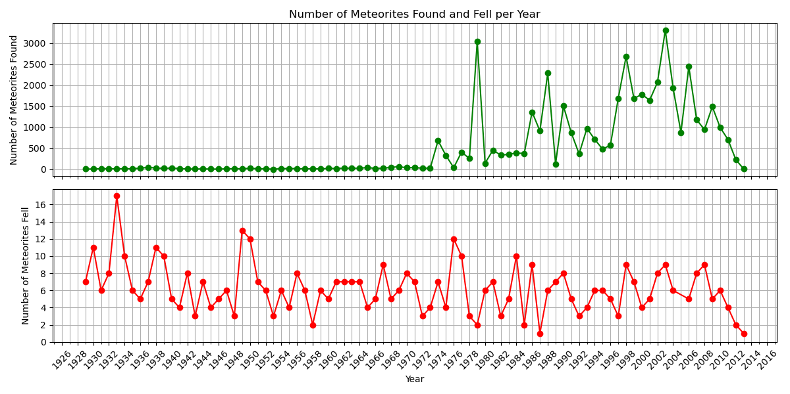
Meteorites per year

Slide 7
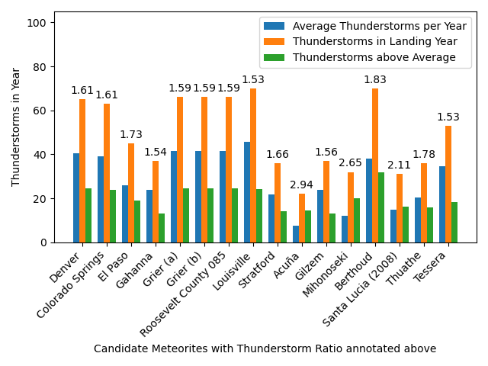
16 Prime Mjolnir Candidates Found

Slide 8
Interactive Map

